Slide 1
Observer Design Pattern

Slide 2
Purpose and Advantage of Pattern
The Observable Design Pattern is very helpful pattern, and one you have likely already used if you have done any significant Java programming
This pattern allows for the definition of a one-to-many dependency between objects so that when one object changes state, all its dependents are notified and updated automatically.
Bindings in Java is a good parallel to use in understanding the Observable pattern. Essential you are able to link object, where one object is modified the linked object will automatically be updated.

Slide 3
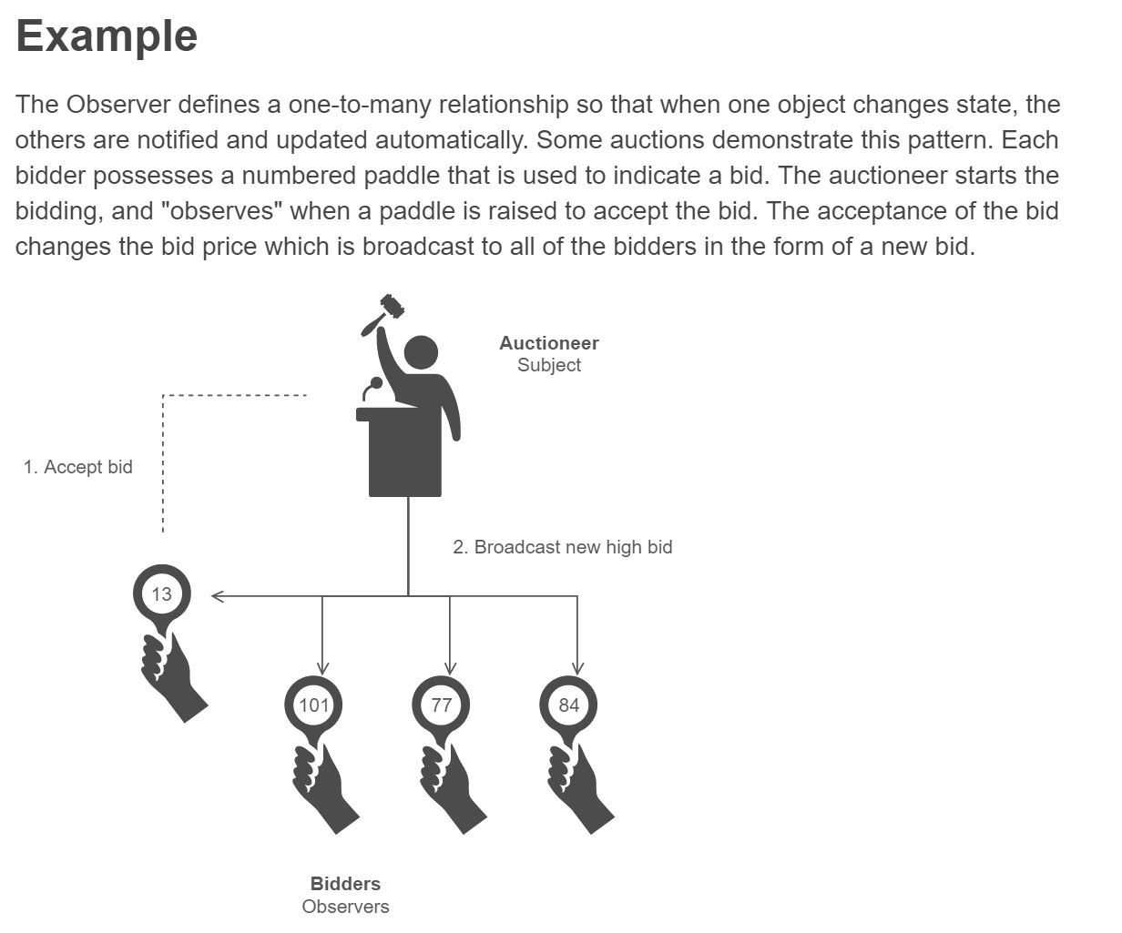
Story
The real world example of an Auctioneer is helpful in understanding the Observer pattern.
Citation for example: https://sourcemaking.com/design_patterns/observer

Slide 4
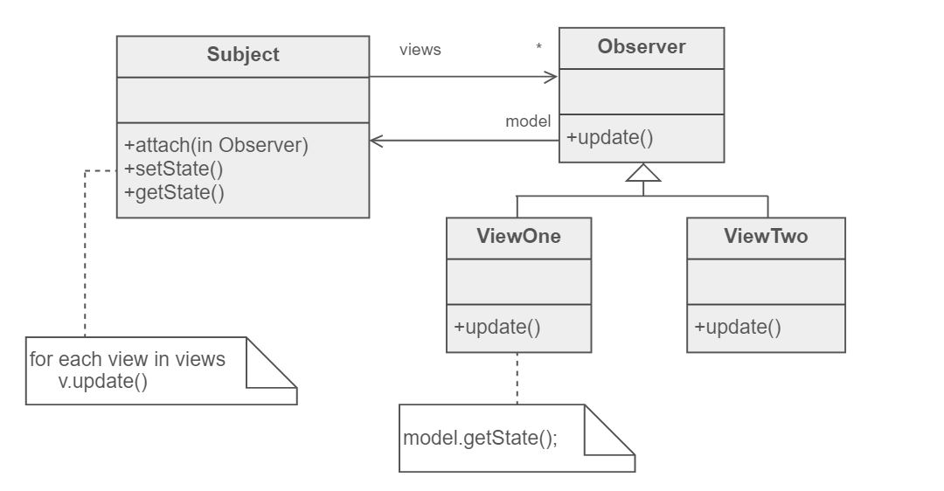
Basic UML for observer pattern
Image source: http://www.people.westminstercollege.edu/faculty/ggagne/may2012/lab2/index.html

Slide 5
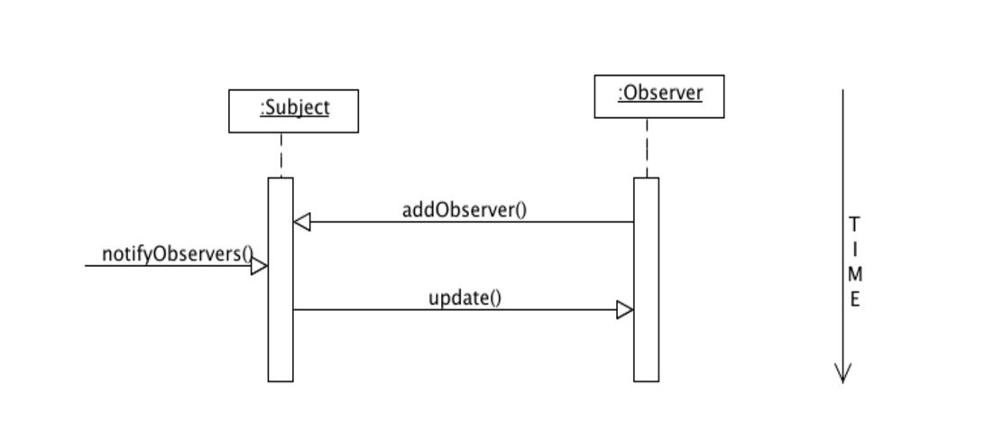
Sequence diagram
Image source: http://www.people.westminstercollege.edu/faculty/ggagne/may2012/lab2/index.html

Slide 6
Code example
For an example of the Auction themed Observer Pattern please refer to code provided at
https://github.com/bcopus/ObserverDesignPattern.git
and also found on the web at
http://www.people.westminstercollege.edu/faculty/ggagne/may2012/lab2/index.html

Slide 7
References
https://dzone.com/articles/design-patterns-uncovered
https://sourcemaking.com/design_patterns/observer
http://www.people.westminstercollege.edu/faculty/ggagne/may2012/lab2/index.html

